Slide 1
Geant4 simulation for optical photons in LAr Aviv Ben Porat avivbenporat@mail.tau.ac.il Tel Aviv University

Slide 2
Objective
Create and validate a Geant4 simulation which correctly simulates optical photon production and propagation in LAr

Slide 3
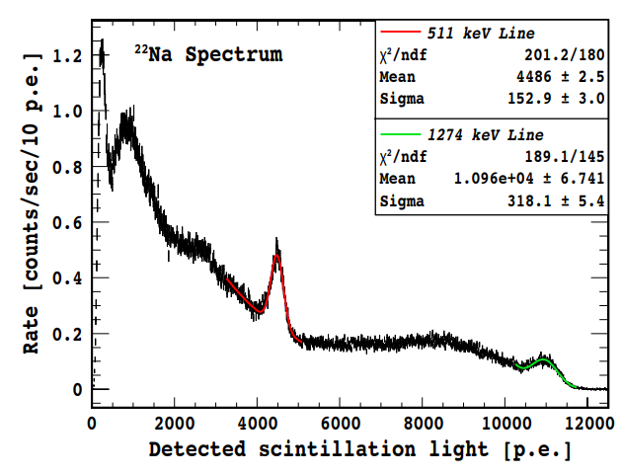
Existing measurement from the Darkside experiment
Darkside measures $γ$ light yield in LAr for DM searches
$22Na$ was placed near the LAr detector and the amount of photoelectrons was measured
The spectrum shown here was background subtracted
The red and green lines are fits for both photopeaks of $22Na$ 511 keV and 1274 keV respectively

Slide 4
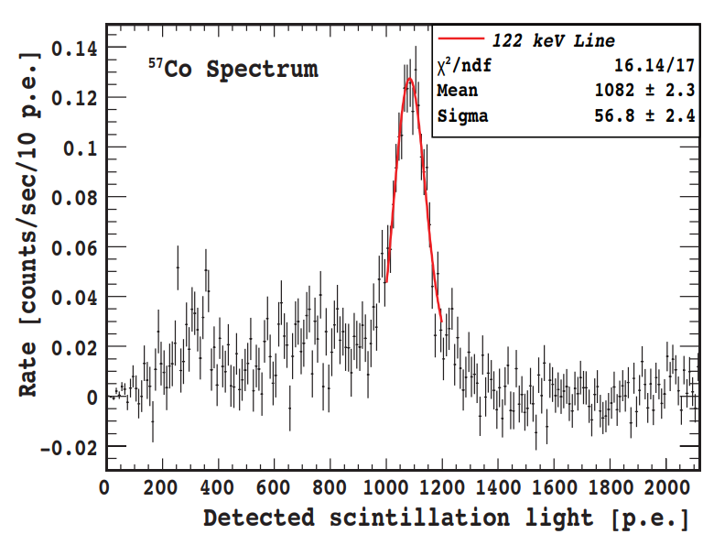
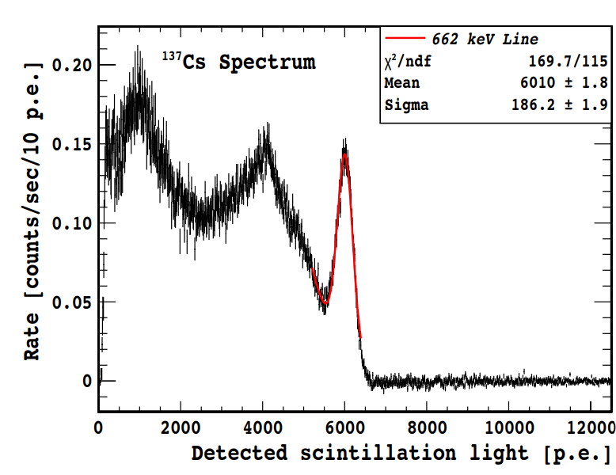
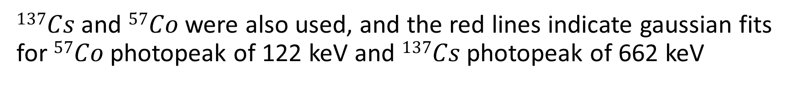
Existing measurement from the Darkside experiment
$137Cs$ and $57Co$ were also used, and the red lines indicate gaussian fits for $57Co$ photopeak of 122 keV and $137Cs$ photopeak of 662 keV

Slide 5
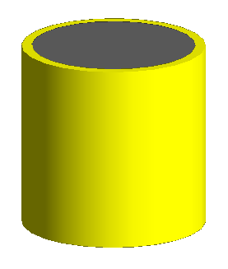
Our simulation
Geometry:
The detector is comprised of a cylindric LAr cell 21 cm in diameter and 23.5 cm tall,
With a 1.9cm thick Acrylic cylinder surrounding it.
Physics List:
QGSP_BERT_HP
G4EmStandardPhysics_option4
opticalPhysics
In our simplified simulation we don’t place a TPB or PMT. Instead we check whether photons reach the effective area of the PMTs placed In the experiment, and then use a random number which includes both the TPB efficiency and the PMT QE to convert photons to photoelectrons.

Slide 6
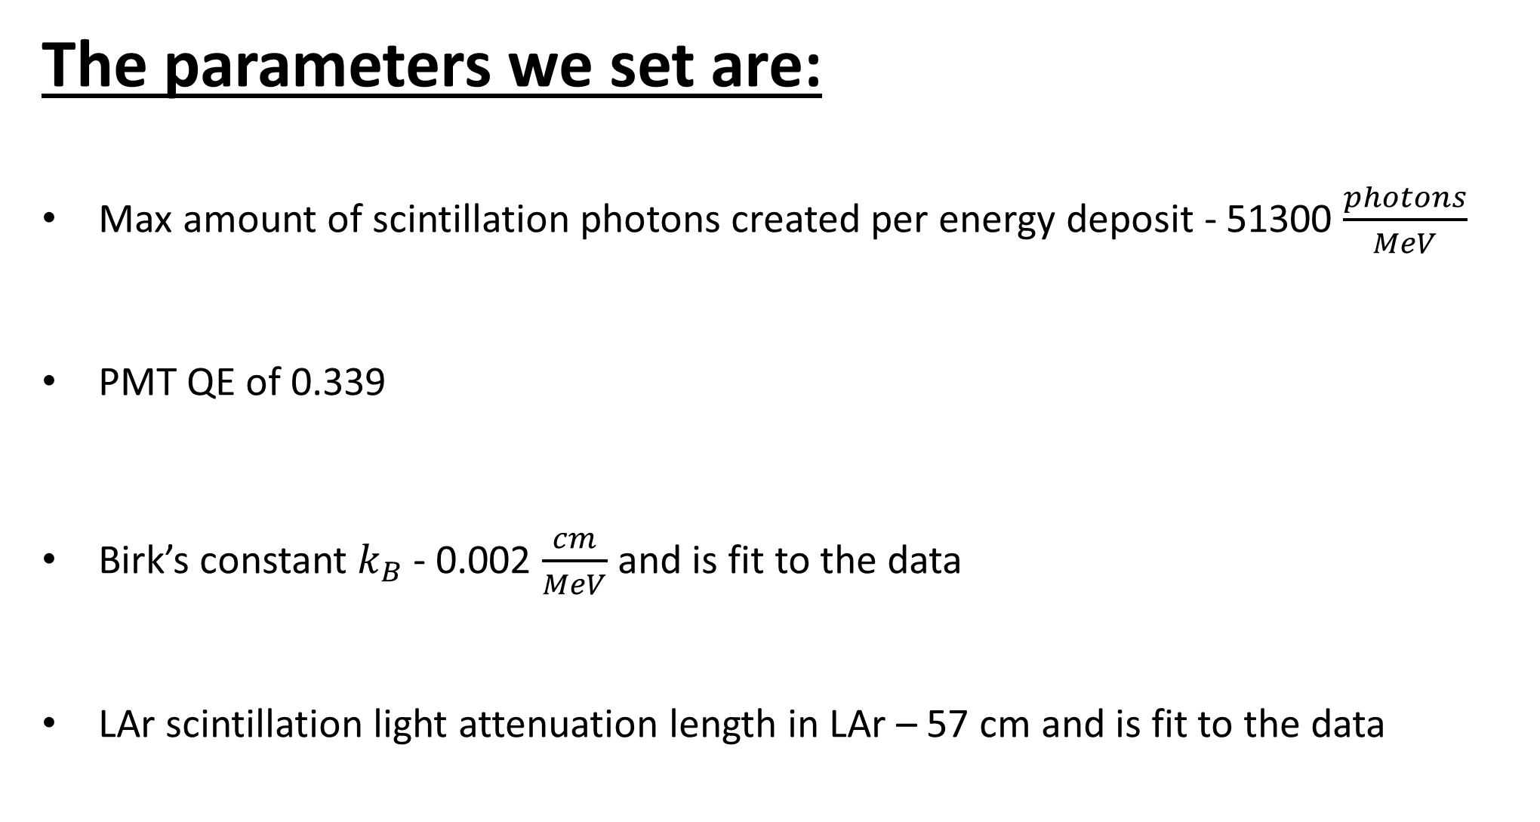
The parameters we set are:
Max amount of scintillation photons created per energy deposit - 51300 $\frac{photons}{MeV}$
PMT QE of 0.339
Birk’s constant $k_{B}$ - 0.002 $\frac{cm}{MeV}$ and is fit to the data
LAr scintillation light attenuation length in LAr – 57 cm and is fit to the data

Slide 7
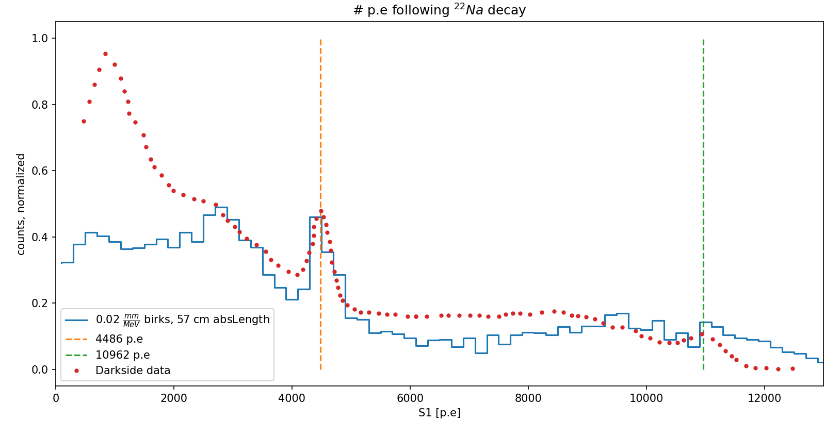
Results:
First fitting attempt – TPB efficiency neglected, assumed to be 1, only PMT QE taken into account – 0.339

Slide 8
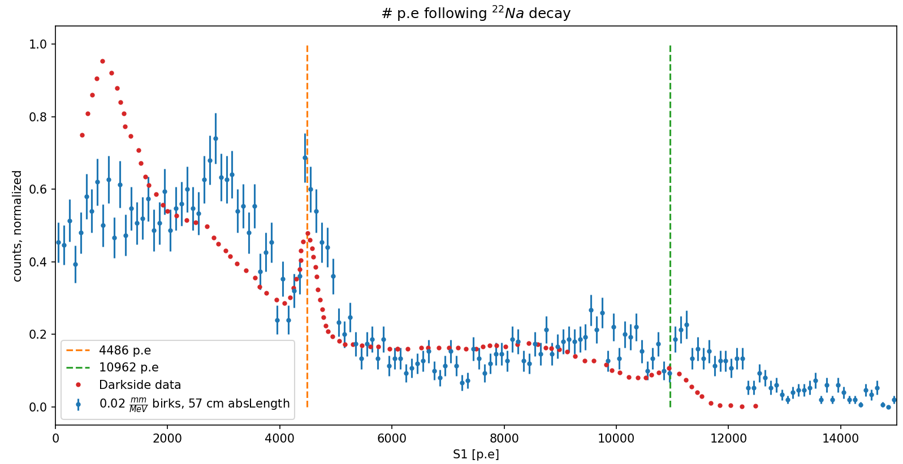
Results:

Slide 9
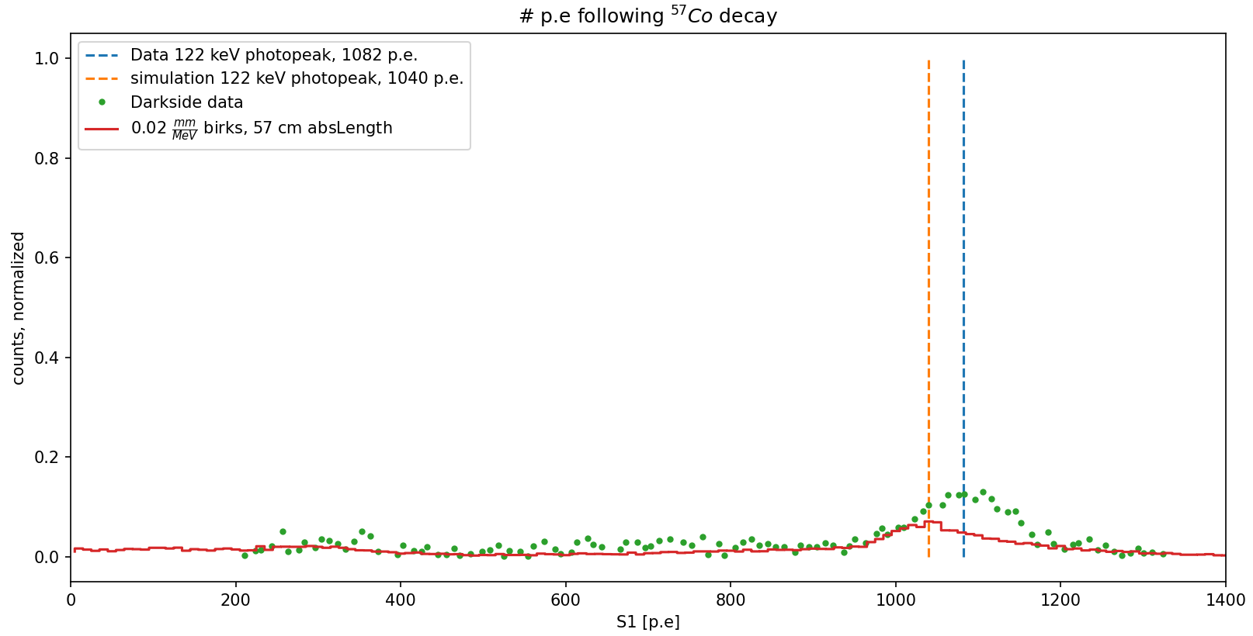
Additional tests:

Slide 10
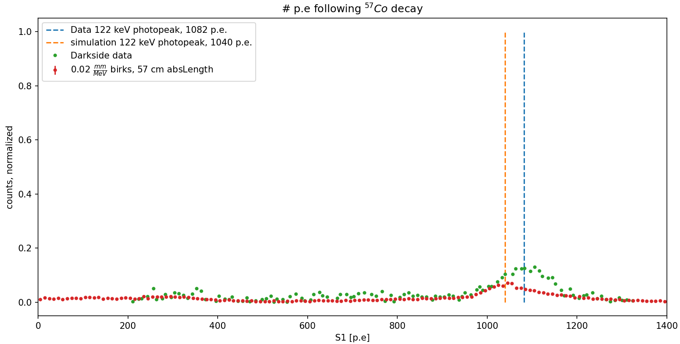
Additional tests:

Slide 11
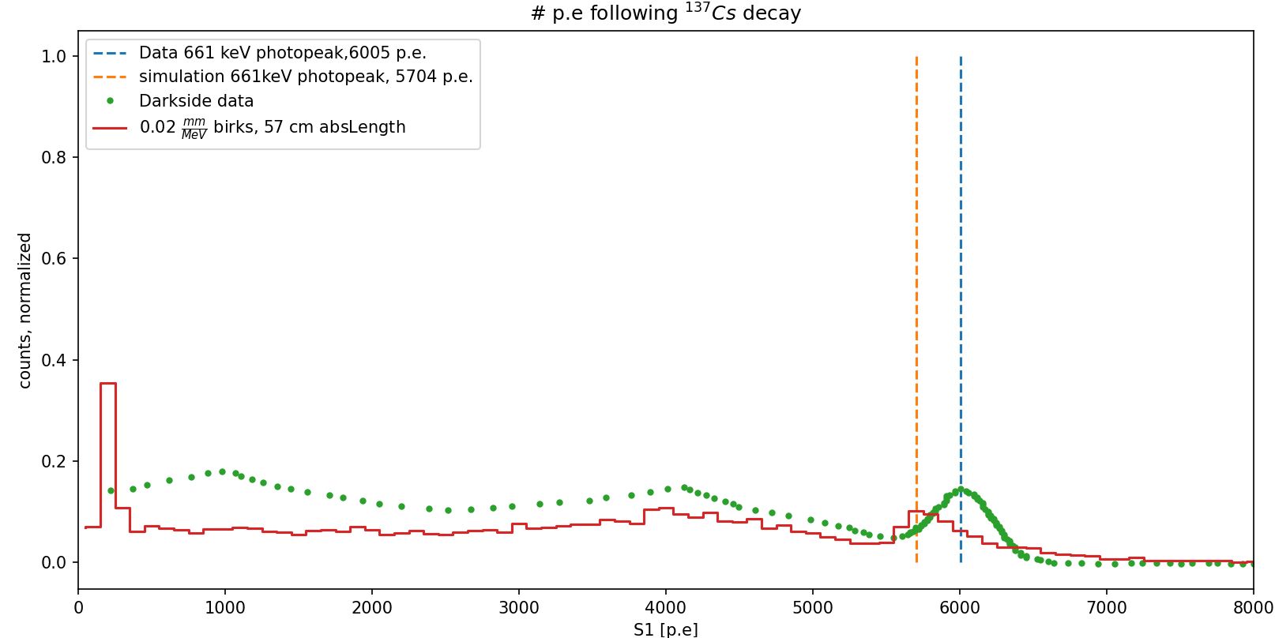
Additional tests:

Slide 12
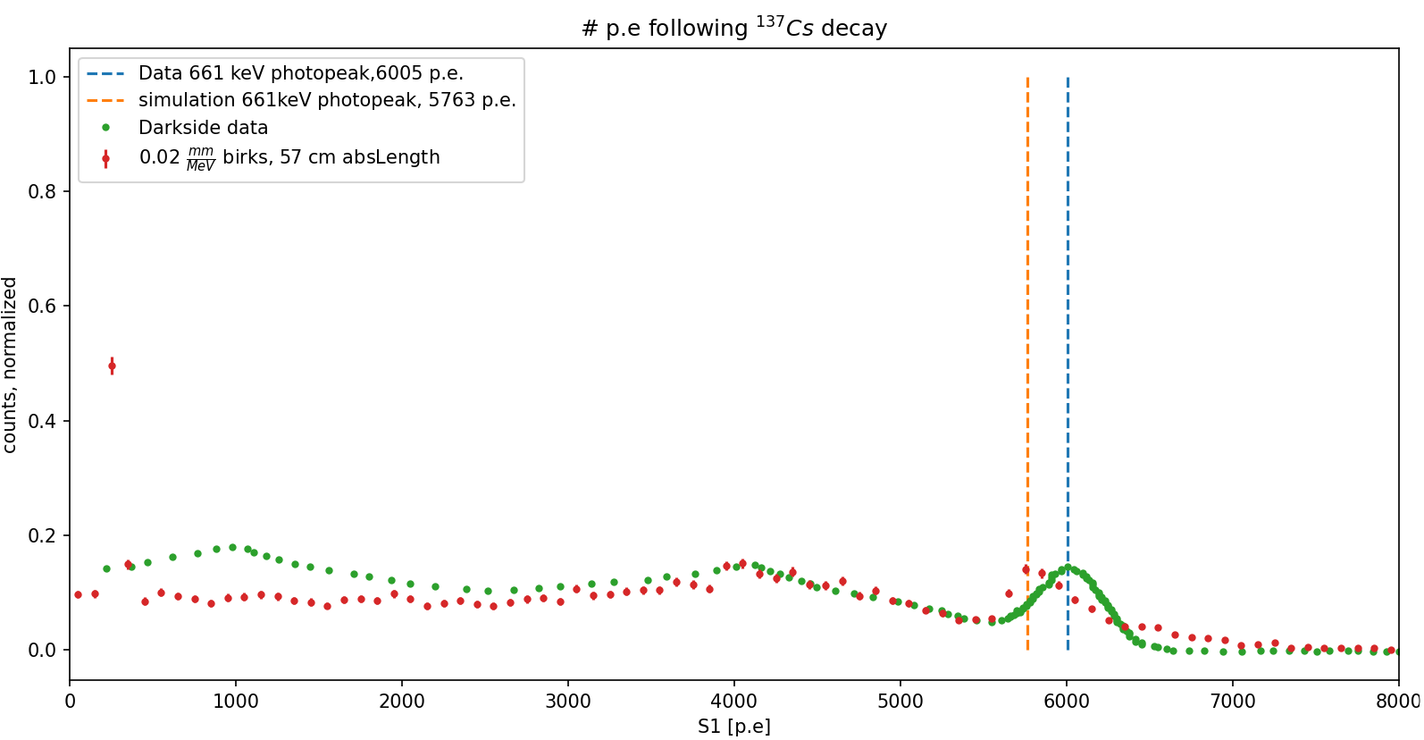
Additional tests:

Slide 13
Literature survey
After performing a literature survey, we realize TPB efficiency could be very different from 1.
C. Benson et al. report about 0.4 TPB efficiency https://doi.org/10.1140/epjc/s10052-018-5807-z
V. M. Gehman et al. report 1.2 TPB efficiency https://doi.org/10.48550/arXiv.1104.3259
J. R. Graybill et al. report about 2.15 TPB efficiency https://doi.org/10.1364/AO.380185
We also realized according to reported purity of LAr contaminants in Darkside, absorption length should be > 30 meters. We are currently working on new fits according to this, taking TPB efficiency as a free parameter instead of absorption length.

Slide 14
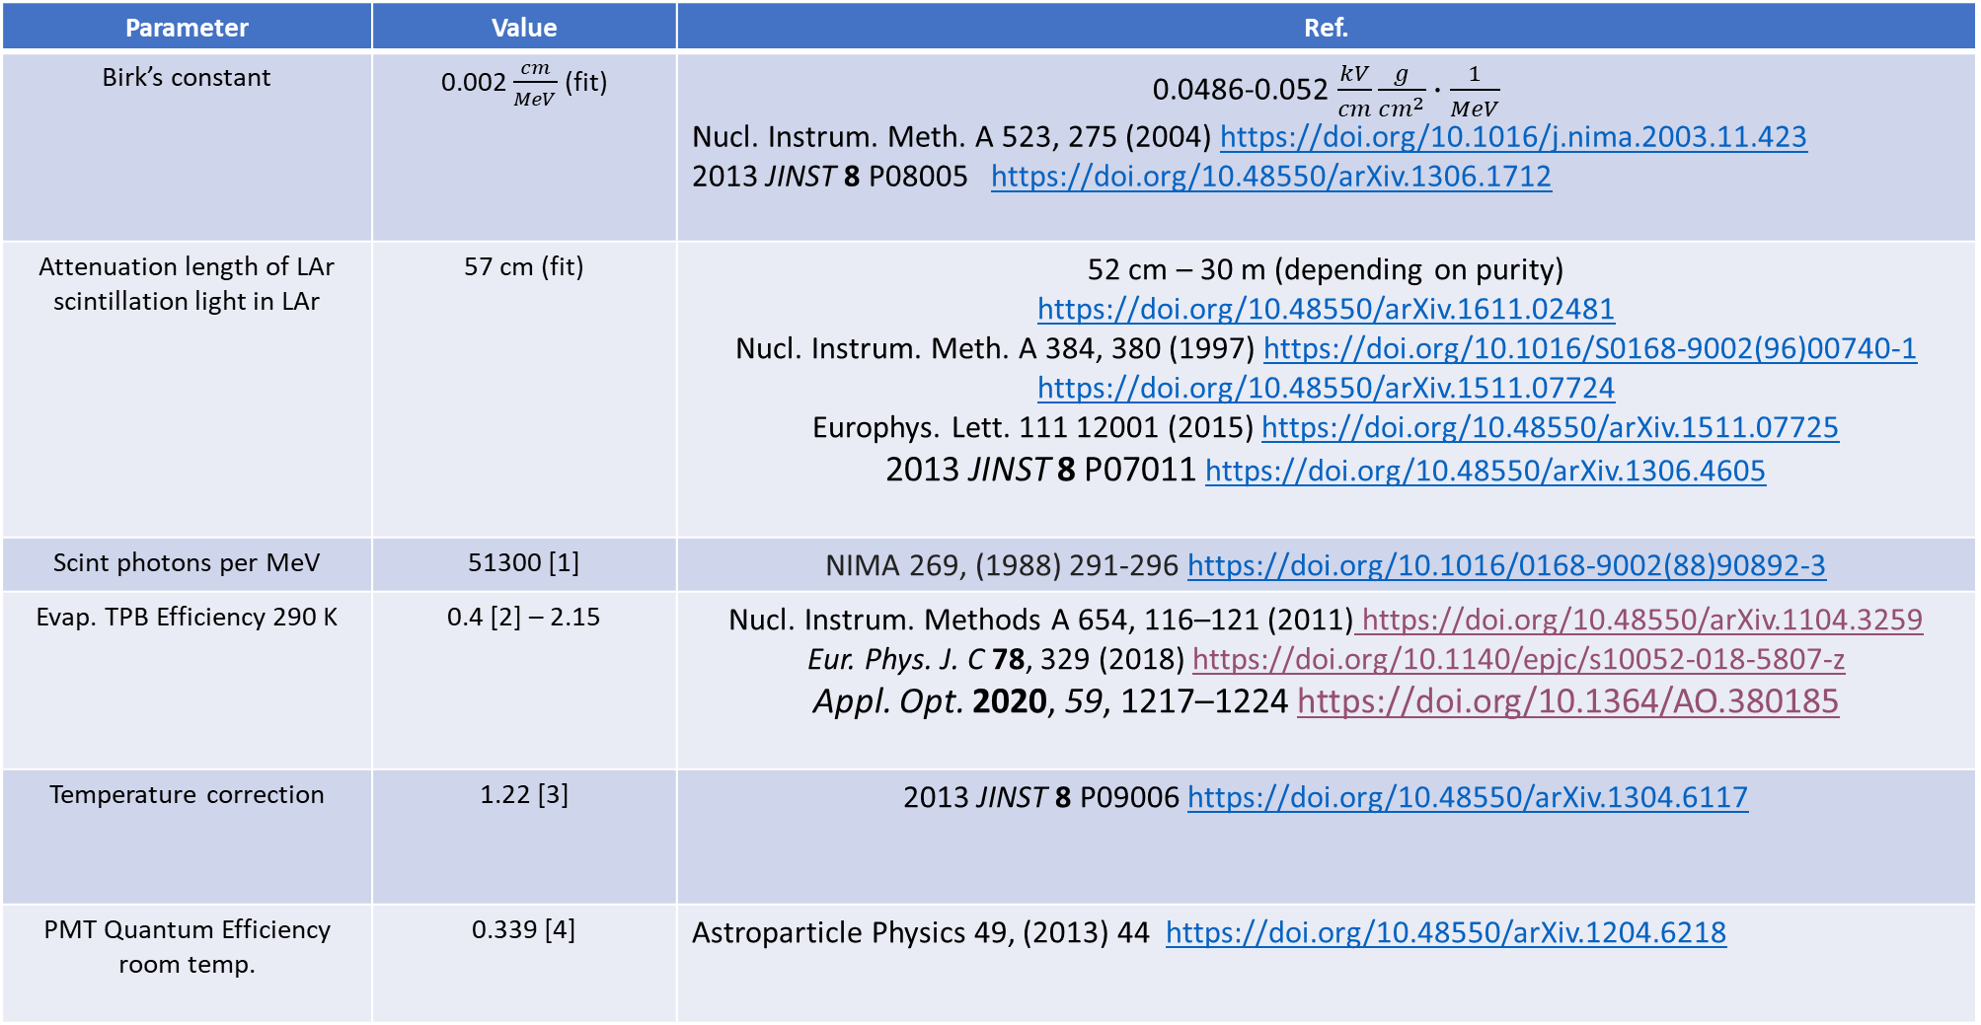
Literature survey
Parameter | Value | Ref.
Birk’s constant | 0.002 $\frac{cm}{MeV}$ (fit) | 0.0486-0.052 $\frac{kV}{cm}\frac{g}{cm^{2}}∙\frac{1}{MeV}$ Nucl. Instrum. Meth. A 523, 275 (2004) https://doi.org/10.1016/j.nima.2003.11.423 2013 JINST 8 P08005 https://doi.org/10.48550/arXiv.1306.1712
Attenuation length of LAr scintillation light in LAr | 57 cm (fit) | 52 cm – 30 m (depending on purity) https://doi.org/10.48550/arXiv.1611.02481 Nucl. Instrum. Meth. A 384, 380 (1997) https://doi.org/10.1016/S0168-9002(96)00740-1 https://doi.org/10.48550/arXiv.1511.07724 Europhys. Lett. 111 12001 (2015) https://doi.org/10.48550/arXiv.1511.07725 2013 JINST 8 P07011 https://doi.org/10.48550/arXiv.1306.4605
Scint photons per MeV | 51300 [1] | NIMA 269, (1988) 291-296 https://doi.org/10.1016/0168-9002(88)90892-3
Evap. TPB Efficiency 290 K | 0.4 [2] – 2.15 | Nucl. Instrum. Methods A 654, 116–121 (2011) https://doi.org/10.48550/arXiv.1104.3259 Eur. Phys. J. C 78, 329 (2018) https://doi.org/10.1140/epjc/s10052-018-5807-z Appl. Opt. 2020, 59, 1217–1224 https://doi.org/10.1364/AO.380185
Temperature correction | 1.22 [3] | 2013 JINST 8 P09006 https://doi.org/10.48550/arXiv.1304.6117
PMT Quantum Efficiency room temp. | 0.339 [4] | Astroparticle Physics 49, (2013) 44 https://doi.org/10.48550/arXiv.1204.6218

Slide 15
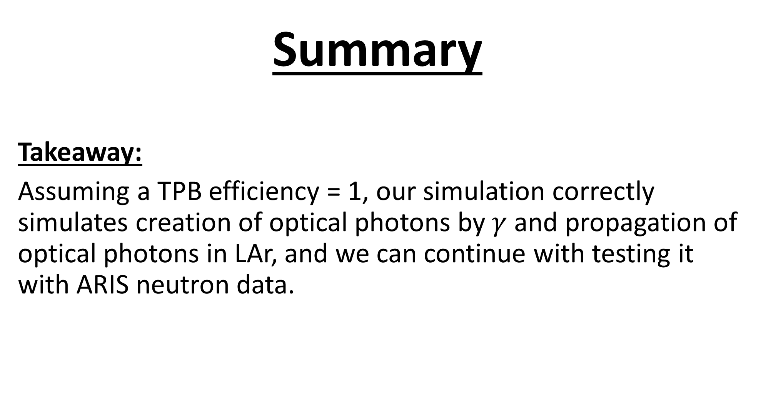
Summary
Takeaway:
Assuming a TPB efficiency = 1, our simulation correctly simulates creation of optical photons by $γ$ and propagation of optical photons in LAr, and we can continue with testing it with ARIS neutron data.

Slide 16
Questions
Questions for the audience:
Does anyone know a reputable source regarding TPB efficiency? Or TPB+PMT efficiency?
What is currently implemented in your simulation?
Are there additional factors for the efficiency?
Your questions

